Slide 1
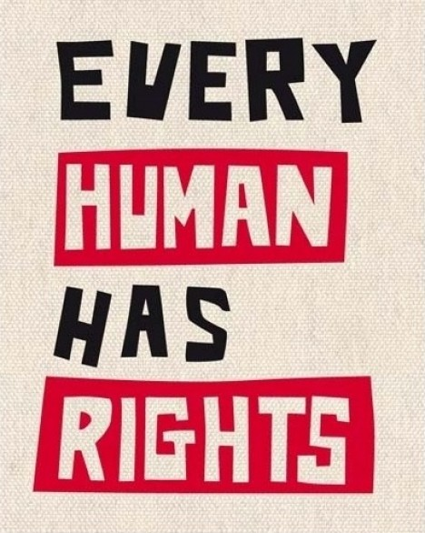
Civil Rights Movements
‘’Civil rights are the rights that people have in a society to equal treatment and equal opportunities, whatever their race, sex, or religion can be.’’
‘’Everyone has the right to life, liberty and security of person.’’
-Article 3 from UDHR (Universal Declaration of Human Rights)

Slide 2
CIVIL RIGHTS MOVEMENTs FROM THE PAST UP TO NOWADAYS
Important Dates to remember
1789s Olympe De Gouges;
1789 French Revolution;
1903 Suffraggettes, feminist movement founded by Emmeline Pankhurts;
1960s Civil Rights’movement for black and white people founded by Martin Luther King;
1970s Nelson Mandela started the Apartheid movement;
1989 Tienanmen square’s protest;
Anti-Mafia movements;
Malala Yousafzai;
Time’s Up.

Slide 3
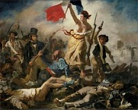
THE FRENCH REVOLUTION
The French revolution was a period of radical and sometimes violent social, political and cultural upheaval that took place in France between 1789 and 1799.
The causes of the French Revolution can be attributed to different factors:
-Eugène Delacroix
The consequences of the French revolution were:
Cultural: Promotion of a new society based on reason.
Social: Birth of a new middle class that aspired to equality policy with the clergy and the aristocracy.
Financial: Louis XVI implemented new taxations and to reduce privileges.
Political: privileged classes' resistance to royal reforms.
Economic: bad harvests and price increase.
The abolition of the absolute monarchy.
the proclamation of the republic with the elimination of the economic and social bases of the so-called Ancien Régime.
the enactment of the Declaration of the rights of man and the citizen.

Slide 4
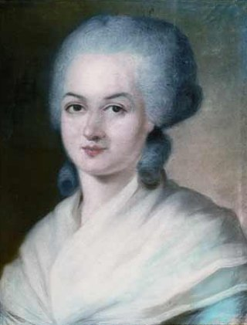
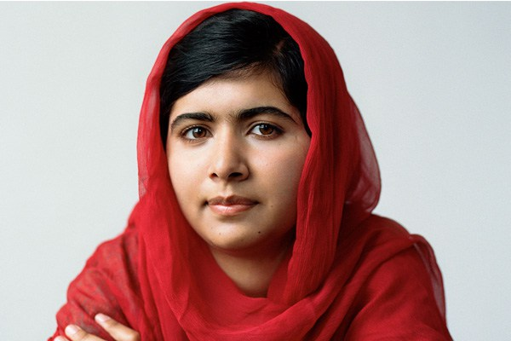
Feminism in the past and nowadays
Olympe De Gouges
Malala Yousafzai
During the French Revolution, Olympe de Gouges dedicated herself to the topic of individual rights and freedom.
She is a Pakistani activist for female education and the youngest Nobel Prize laureate.
‘’When the whole world is silent, even one voice becomes powerful.’’
‘’Woman is born free and lives equal to man in her rights. Social distinctions can be based only on the common utility.’’

Slide 5
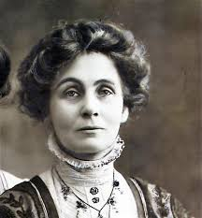
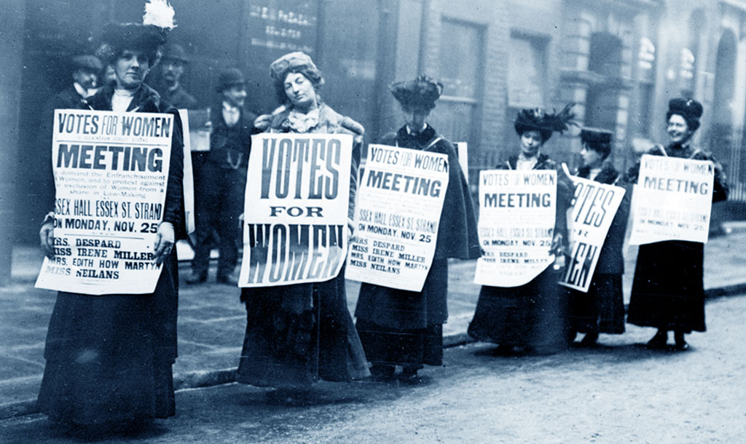
Emmeline Pankhurts formed The Women's Social and Political Union, also called the Suffragettes, in 1903.
The Suffragettes were a group who fought for women’s rights, especially the right to vote.
In 1918, the British government gave women aged over 30 the right to vote and after Emmeline’death , Women were finally allowed to vote at the same age as men.
The Suffragettes also held demonstrations, and they often broke the law by smashing windows or chaining themselves to fences to protest.

Slide 6
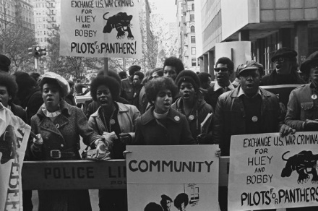
MARTIN LUTHER KING
Was a social activist who worked for african americans’ civil rights. He has also helped in the development of the Black Panther organization.
Black Panther Party
The Black Panthers were a group, founded by Huey P.Newton and Bobby Seale during the Civil Rights Movement that urged African Americans to fight for their rights.
“If you can't fly then run, if you can't run then walk, if you can't walk then crawl, but whatever you do you have to keep moving forward.”
-Martin Luther King Jr.
They asked for the abolition of slavery, equal rights and same opportunities between white and black men.

Slide 7
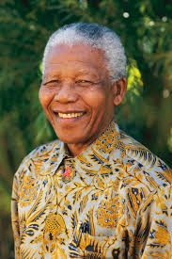
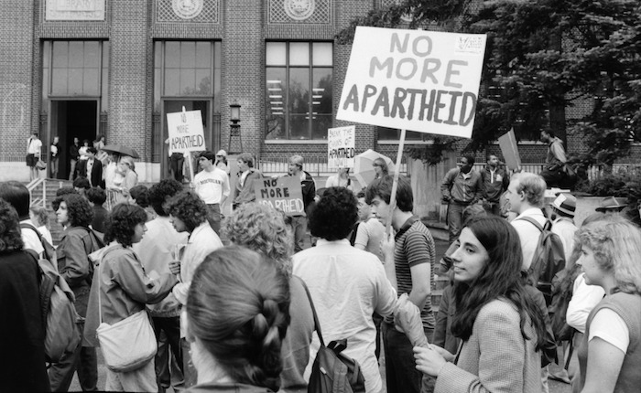
NELSON MANDELA
The
ANTI-APARTHEID MOVEMENT was one of the strongest solidarity movements against apartheid in South Africa. Based on anger at injustice, it helped change the world for the better.
Nelson Mandela was a South African anti-apartheid revolutionary, political leader, and philanthropist, who served as President of South Africa and fought against Apartheid.
APARTHEID refers to the racial segregation policy established by the South African white government.
“Do not judge me by my successes, judge me by how many times I fell down and got back up again.” –Nelson Mandela

Slide 8
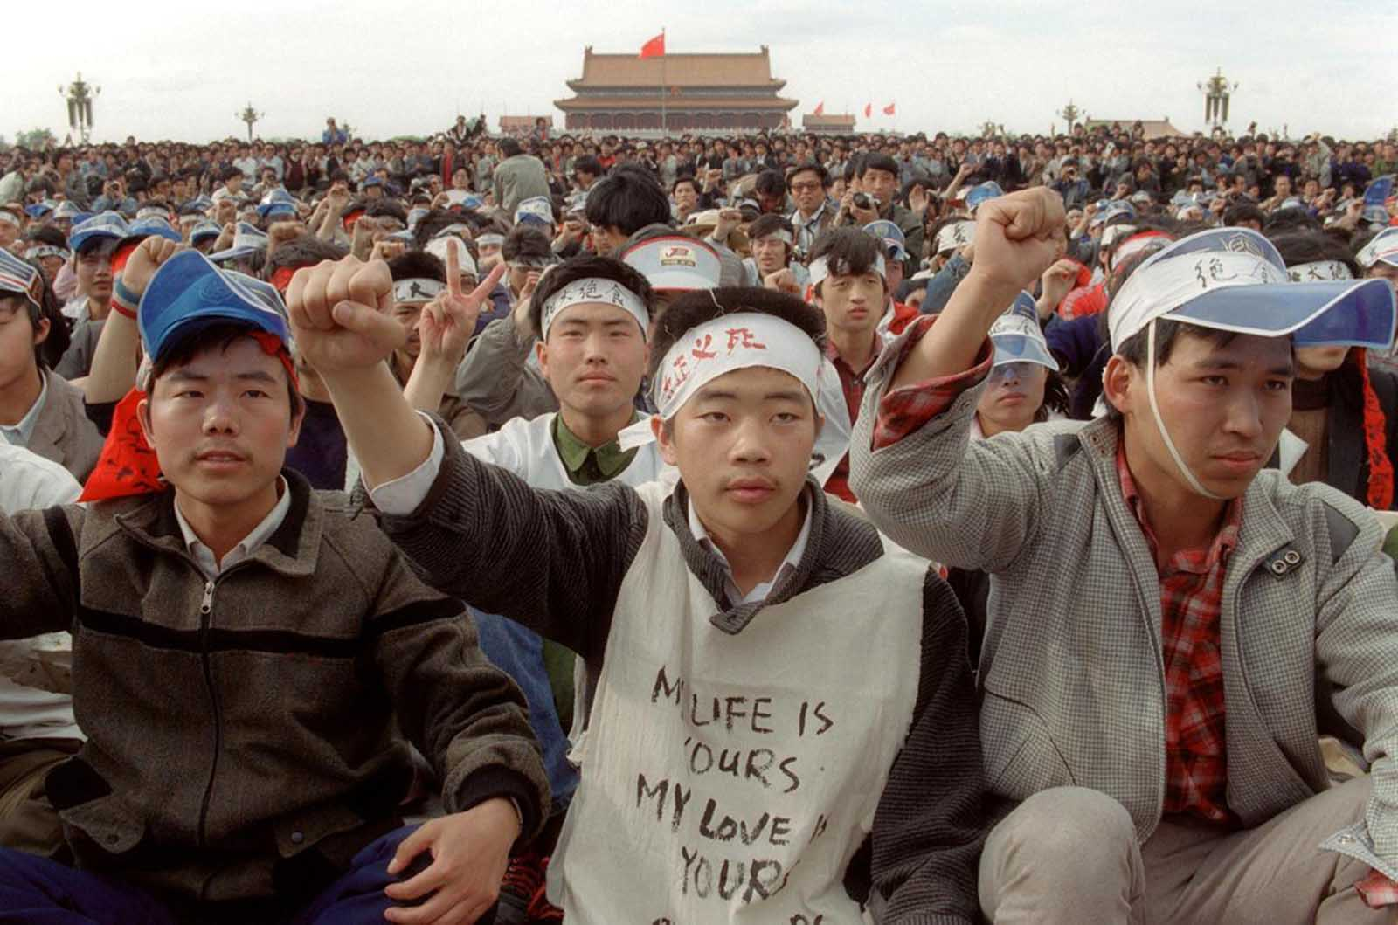
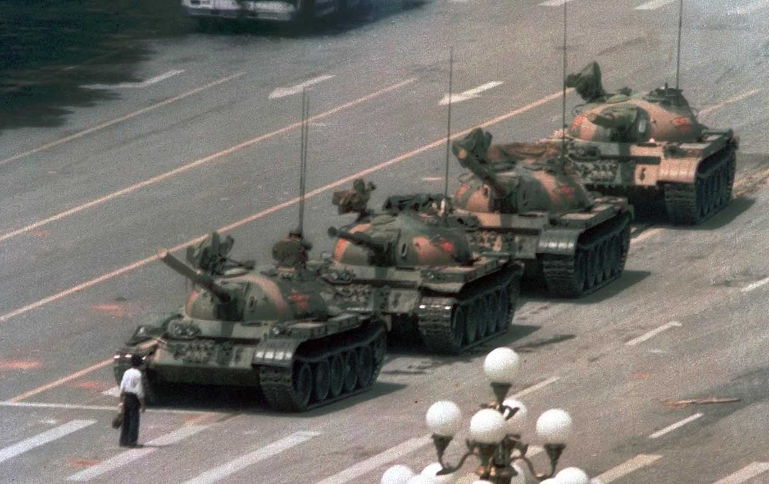
TIANANMEN SQUARE PROTESTS IN CHINA
A million of upekinese university students poured into the Tiananmen Square, in front of the Forbidden City (the former residence of the emperors) to demand the abolition of all forms of despotism and greater political freedom.
Martial law was proclaimed. The tough stance of the regime, however, did not stop the protest but on the night between 3 and 4 June 1989 the military surrounded the square with armored vehicles. The following day they opened fire on the demonstrators, causing a massacre.
Notes:
There was something that really surprised me during my researches on this horrible event and it is the fact that this was called an "accident". This was not an accident. But let's go on.

Slide 9
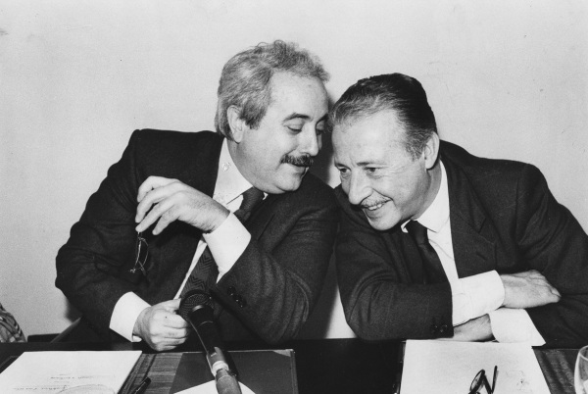
GIOVANNI FALCONE AND PAOLO BORSELLINO
They were killed but no one will ever forget what Paolo Borsellino and Giovanni Falcone did.
Paolo Borsellino and Giovanni Falcone were two magistrates, two men who in the eighties discovered the secrets of this organization called Cosa Nostra. They have shown that working together can be a winning weapon.
Along with Antonio Caponnetto, they founded a "pool" against the Mafia thanks to which they captured hundreds of convicted mafiosi in the now famous maxi-trial concluded on 30 January 1992.

Slide 10
ANTI-MAFIA MOVEMENTS
Anti-mafia is the fight against Mafia and its criminal activities borned in the south of Italy and then, spreaded all around the world.
“He who is silent and bows his head dies every time he does so. He who speaks aloud and walks with his head held high dies only once.’’ –Giovanni Falcone
The Addiopizzo Committee is an Italian anti-mafia movement, born and developed in Palermo in 2004, mainly engaged in the fight against the racketeering of mafia extortions.
“An entire people that pays pizzo is a people without dignity.”

Slide 11
Time’s Up is a movement against sexual harassment that was founded this 1st Janaury thanks to Hollywood celebrities.
TIME’S UP on silence.
TIME’S UP on waiting.
TIME’S UP on tolerating discrimination, harassment and abuse.

Slide 12
Emma Watson is a famous actress who is one of the Time’s Up’s supporter. She has been working for equality between men and women.
‘’It is time that we all see gender as a spectrum instead of two sets of opposing ideals.’’
-Emma Watson
Notes:
This is something that I think we should really think about because it's time to break this difference between women and men. We can do it together.

Slide 13
Made by: Erika Di Noto with the help of Laura Flauto

